Slide 1





Recruitment and Training & Development Practices at Cars24
Field Based Team Project
Presentation by Learning Team 2

Slide 2



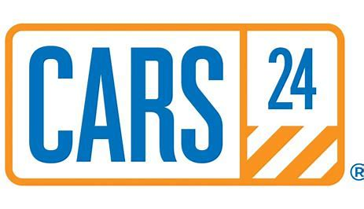


Industry Selected
Automotive and E-commerce Industry The automotive industry focuses on the design, manufacturing, and distribution of vehicles, while the e-commerce sector enables online transactions. Cars24 merges these industries, transforming the pre-owned car market through its technology-driven platform, offering convenience and efficiency to buyers and sellers.
Company: Cars24
Cars24 is a leading platform for buying, selling, and exchanging pre-owned vehicles, known for disrupting the auto-tech industry with its innovative, customer-centric solutions. The company leverages technology to provide a seamless, transparent experience, offering services such as online car valuations and home delivery, which enhance convenience for buyers and sellers.

Slide 3
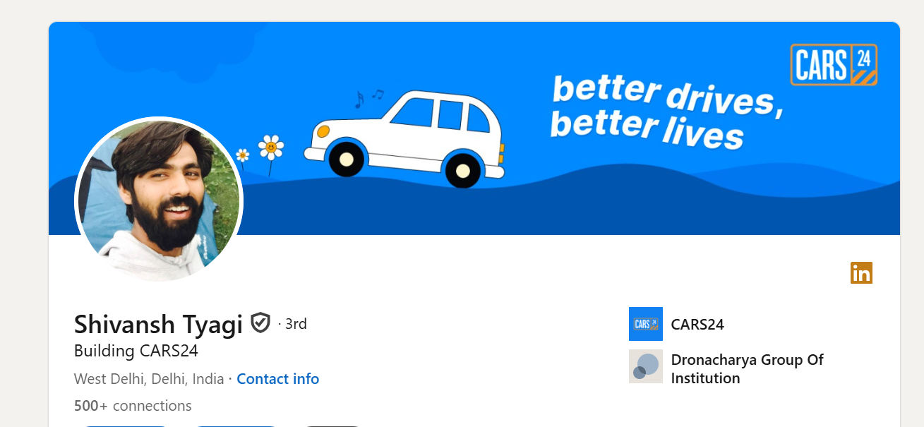
About HR manager
Name: Shivansh Tyagi
Designation: Senior Manager Talent Acquisition
Experience: 10 years
Current company in which he is working: Cars24

Slide 4
Questions Asked
Question 1: What is the recruitment strategy Cars24 follows for sourcing and hiring talent?
Response
Employee Referrals
Direct Hiring
Consultants and Recruitment Agencies
AI and Data-Driven Tools
Question 2: Which platforms or methods are most effective for sourcing candidates at Cars24?
Response: The most effective platforms for sourcing candidates at Cars24 include LinkedIn, job portals like Naukri, Shine and employee referral programs, which ensure quality and cultural fit.

Slide 5
Question 3: What key performance indicators (KPIs) are used to measure the success of recruitment efforts?
Response: Key performance indicators (KPIs) used to measure recruitment success at Cars24 include the selection percentage, indicating the ratio of candidates selected to those interviewed, and the sourcing-to-offer ratio, assessing the effectiveness of sourcing channels. Time-to-hire measures the duration taken to fill a position, while quality of hire evaluates new hires' performance and cultural fit. Cost-per-hire tracks the total expenses incurred during the recruitment process, ensuring cost efficiency.
Question 4: Does Cars24 use any technology (e.g., AI, recruitment platforms) to streamline hiring?
Response: Yes, Cars24 leverages AI-driven tools like Toggle for skill matching and Firefly for automating interview scheduling. It uses ATS to track applications and AI for candidate matching, while chatbots provide real-time application support. These technologies streamline hiring, enhance efficiency, and improve the candidate experience.

Slide 6
Process Followed in the Function
A. Recruitment Process
Job Requirement Analysis: HR and department heads define role-specific requirements to ensure clarity in needed skills and competencies.
Talent Sourcing: Uses online platforms, employee referrals, and recruitment agencies to attract diverse talent.
Candidate Assessment: Combines technical tests and panel interviews to evaluate skills and cultural fit.
B. Training & Development Process
Training Needs Assessment: Identified via performance reviews, KPI analysis, and employee feedback.
Training Module Development: Focuses on technical skills, leadership workshops, and soft skills training.
On-the-Job Training: Provides hands-on experience through real-life scenarios and practical exercises.

Slide 7
Best Practices at Cars24
Technology-Driven Recruitment
Data-Driven Decision Making
Cars24 leverages advanced technological tools to enhance the efficiency and accuracy of its recruitment process, including ATS, AI integration and chatbots.
Performance metrics and training ROI are meticulously tracked to evaluate and optimize recruitment and training efforts.
Structured Onboarding Process
Customized Training Programs
New hires undergo a comprehensive onboarding program designed to foster engagement and cultural alignment, including mentorship programs and cultural integration
Programs are tailored to enhance both technical skills and soft skills, ensuring relevance to employees’ roles and career paths, including needs-based assessments and role-specific content.

Slide 8
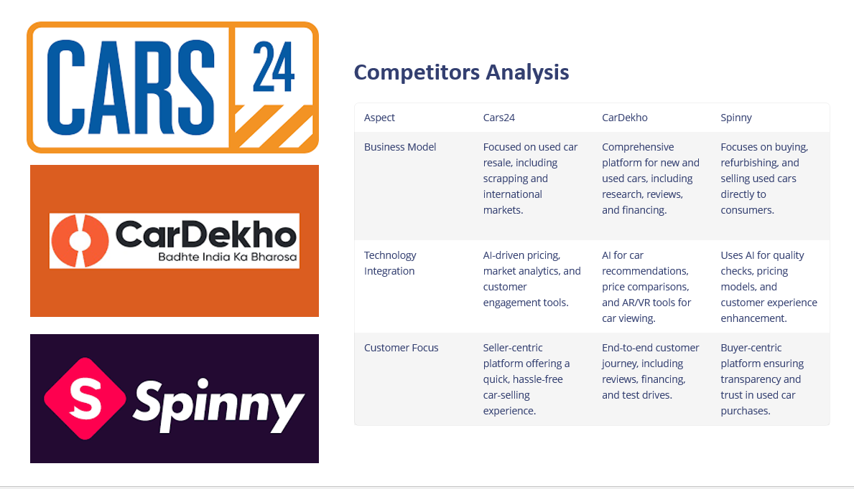

Slide 9
Key Insights: A Data-Driven Approach
1.Integration of Technology
2.Focus on Employee Experience
Cars24 leverages advanced technology in both recruitment and training processes, including ATS, AI and e-learning platforms.
Cars24 emphasizes on creating a positive employee experience throughout the recruitment and onboarding journey, including a transparent recruitment process and structured onboarding.
3.Personalized Training and Development
4.Data-Driven HR Practices
Cars24 offers customized training programs tailored to individual needs, including skill gap analysis, role-specific training, and career growth alignment.
Data analytics underpin Cars24’s HR strategies, ensuring informed decision-making, including performance metrics and employee feedback.

Slide 10
Conclusion
Cars24 combines technology and employee-focused strategies to excel in recruitment and training. By leveraging tools like ATS and AI platforms, the company streamlines hiring, enhances efficiency, and delivers an exceptional candidate experience. Tailored training initiatives, including microlearning and leadership workshops, foster continuous learning, aligning employee growth with organizational goals to boost engagement and retention. Data-driven decision-making, guided by KPIs and feedback, ensures HR processes remain aligned with business objectives, creating a dynamic work environment that supports efficiency, talent development, and sustainable growth.

Slide 11
Recommendations for Continued Success
1
Adopting Predictive Analytics
2
Enhancing Feedback Systems
3
Expanding Cross-Functional Training
4
Strengthening Leadership Development

Slide 12
THANK YOU

